Slide 1

Flight Data Analysis USING OOZIE WORKFLOW
By:
NAGA DATHA SaiKiran BATTULA
Harshith gade
Sai nikhil DUNUKA
Yashwanth reddy BUSHIREDDY

Slide 2

Project overview
Objective: To analyze airline on-time performance data in order to identify trends and gain insights.
Tools Utilized:
Hadoop: A distributed data processing framework.
Oozie: A workflow scheduler designed for Hadoop jobs.
AWS: A cloud computing platform used for hosting virtual machines.

Slide 3
4V's
Flight Data (Harvard University)
Volume: The dataset comprises a significant volume of data, with nearly 120 million records in total.
Veracity: Ensuring the veracity, or accuracy and reliability, of the dataset is crucial for meaningful analysis and decision-making.
Velocity: The data captures flight arrival and departure details for all commercial flights within the USA from October 1987 to April 2008.
Variety: The dataset exhibits variety in terms of the types of information captured for each flight, including timestamps, categorical variables (such as carrier codes and airport codes), and numerical variables (such as distances and delays)

Slide 4

Dataset description
Source: Airline On-time Performance dataset obtained from Harvard Dataverse.
Details of the Dataset:
Time Period: October 1987 to April 2008.
Size: 1.5 GB
Format: CSV (Comma-Separated Values).
After Extraction: 10.5 GB

Slide 5
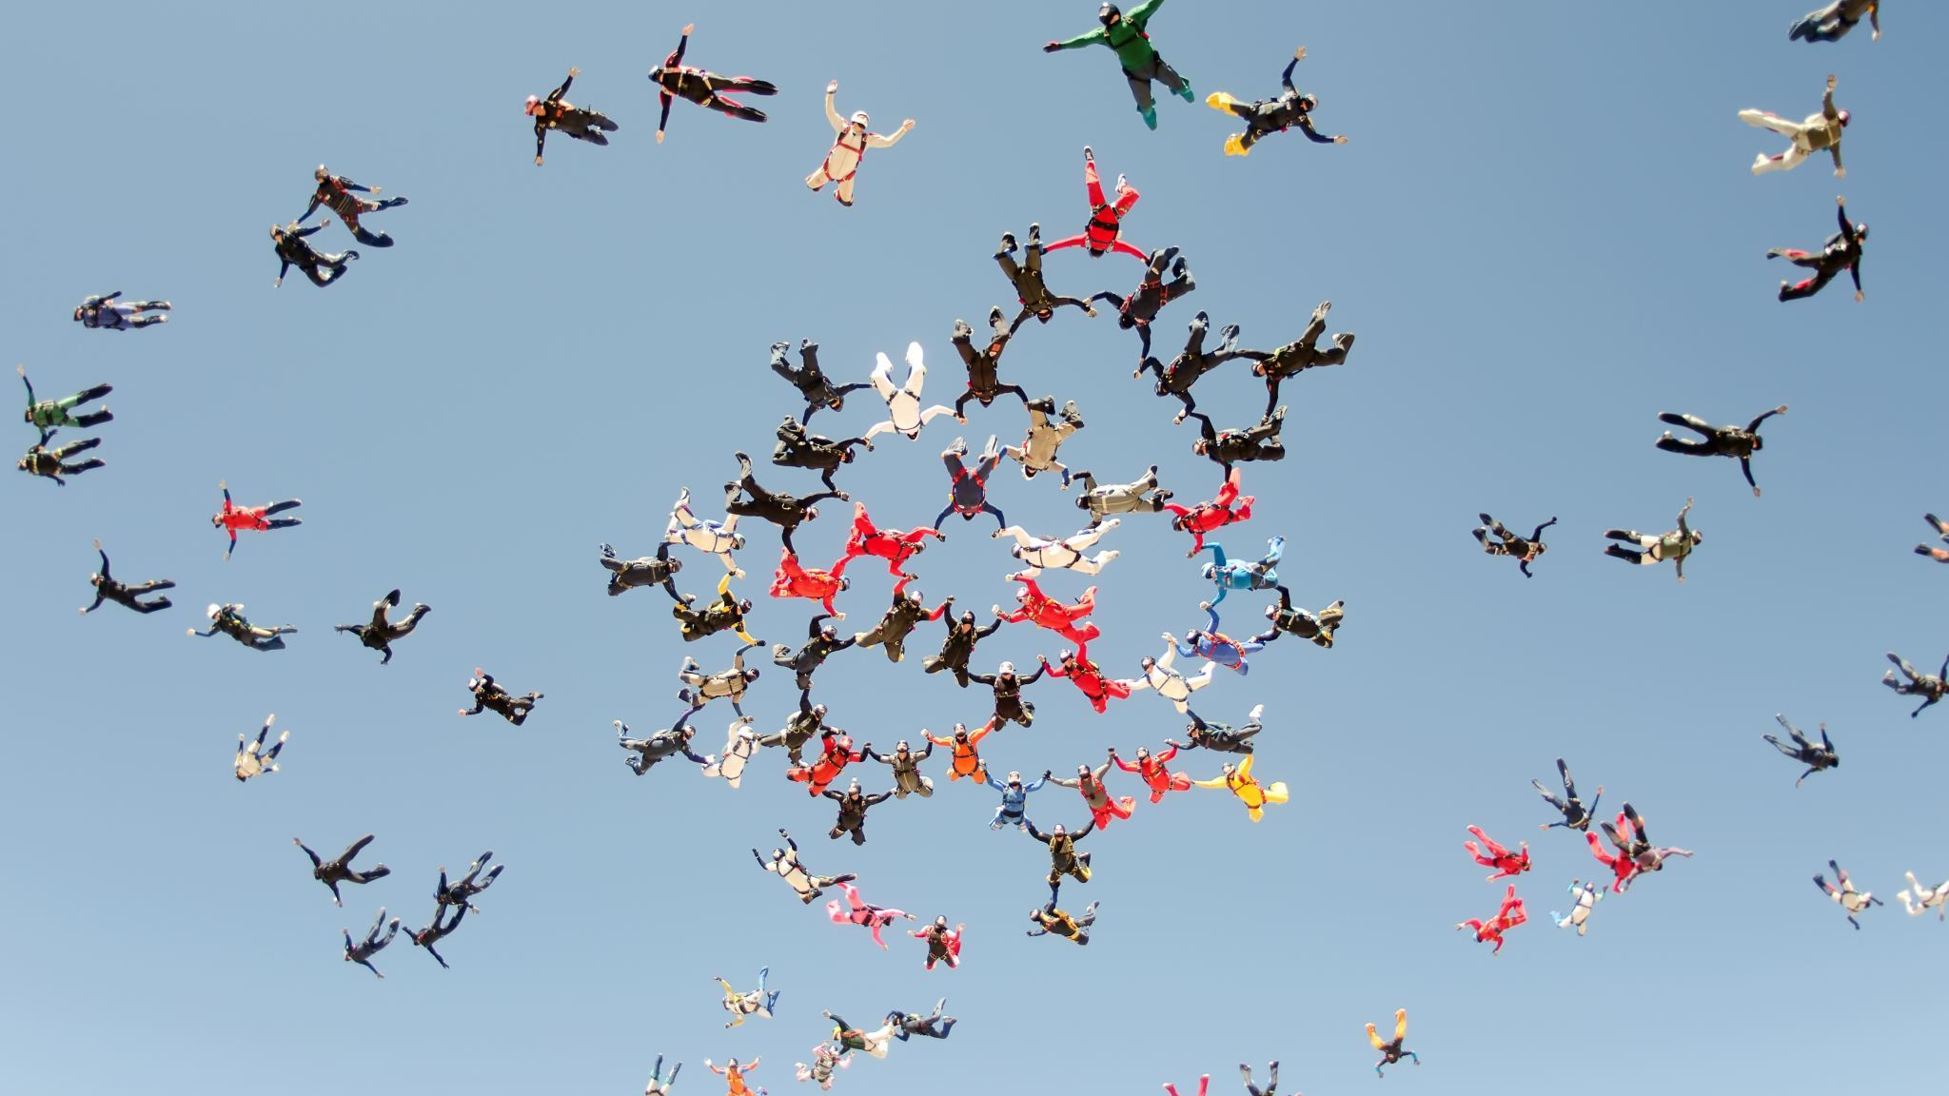
Tasks to achieve
Design, implement, and execute an Oozie workflow to accomplish the following tasks:
1. Identify the three airlines with the highest and lowest probability of being on schedule.
2. Determine the three airports with the longest and shortest average taxi time per flight (both inbound and outbound).
3. Find the most common reason for flight cancellations.
Would you like a breakdown of how to approach each of these tasks in the Oozie workflow?

Slide 6
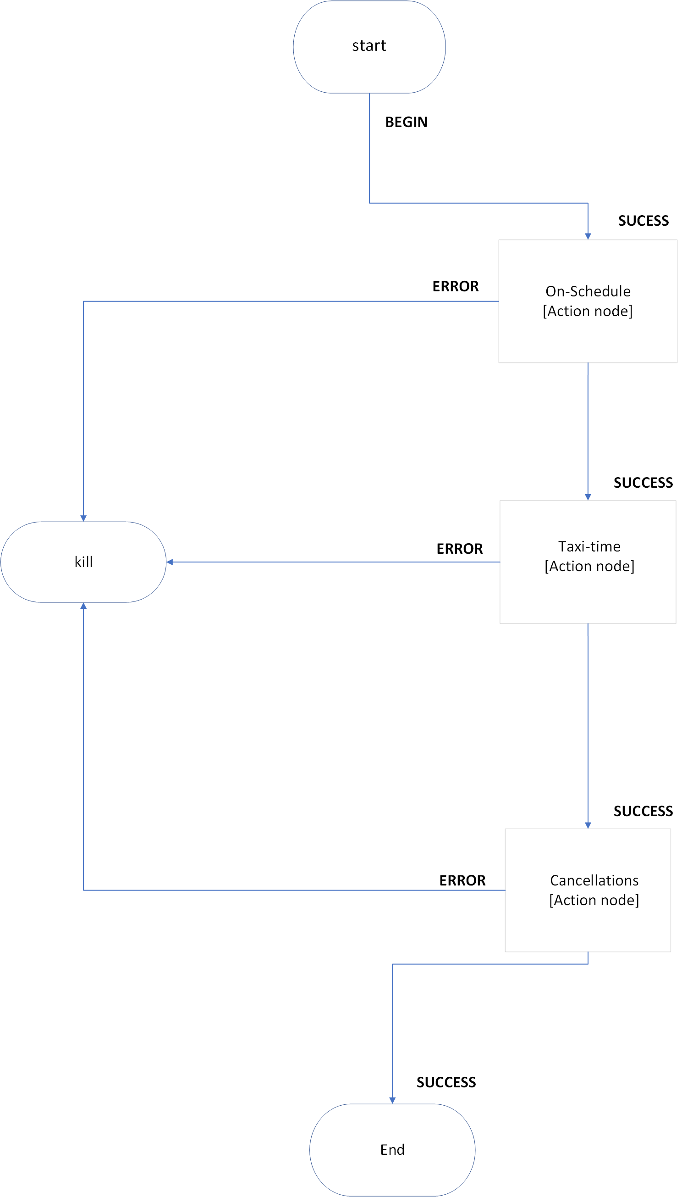
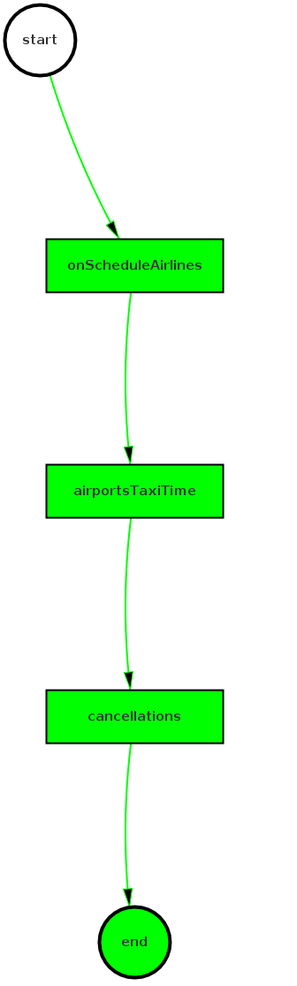
Oozie workflow design
In Apache Oozie, which is a workflow scheduler system for managing Apache Hadoop jobs, workflows are defined as a collection of control flow nodes and action nodes organized in a directed acyclic graph (DAG). This Graph is generated from the oozie web console.

Slide 7
Oozie workflow
Start Node:
Initiates the workflow.
Job A: Identify Airlines with Highest and Lowest On-Time Performance:
This job will analyze historical flight data to determine the on-time performance of airlines.
Output: Top three airlines with the highest probability for being on schedule and the bottom three with the lowest probability.
Job B: Identify Airports with Longest and Shortest Average Taxi Times:
This job will analyze taxi time data to identify airports with the longest and shortest average taxi times per flight.
Output: Top three airports with the longest average taxi times and the top three with the shortest average taxi times.
Job C: Identify Most Common Reasons for Flight Cancellations:
This job will analyze flight cancellation records to determine the most common reasons for flight cancellations.
Output: Most common reasons for flight cancellations.
End Node:
Marks the end of the workflow.

Slide 8
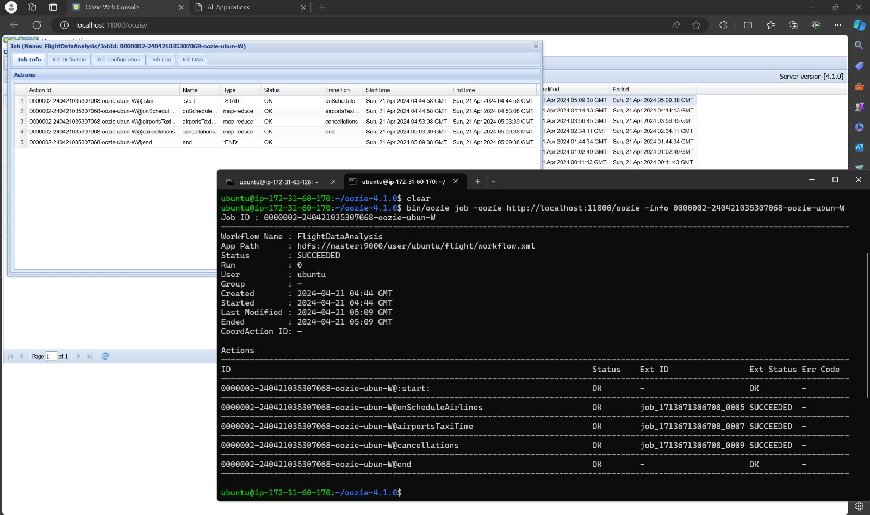

Slide 9
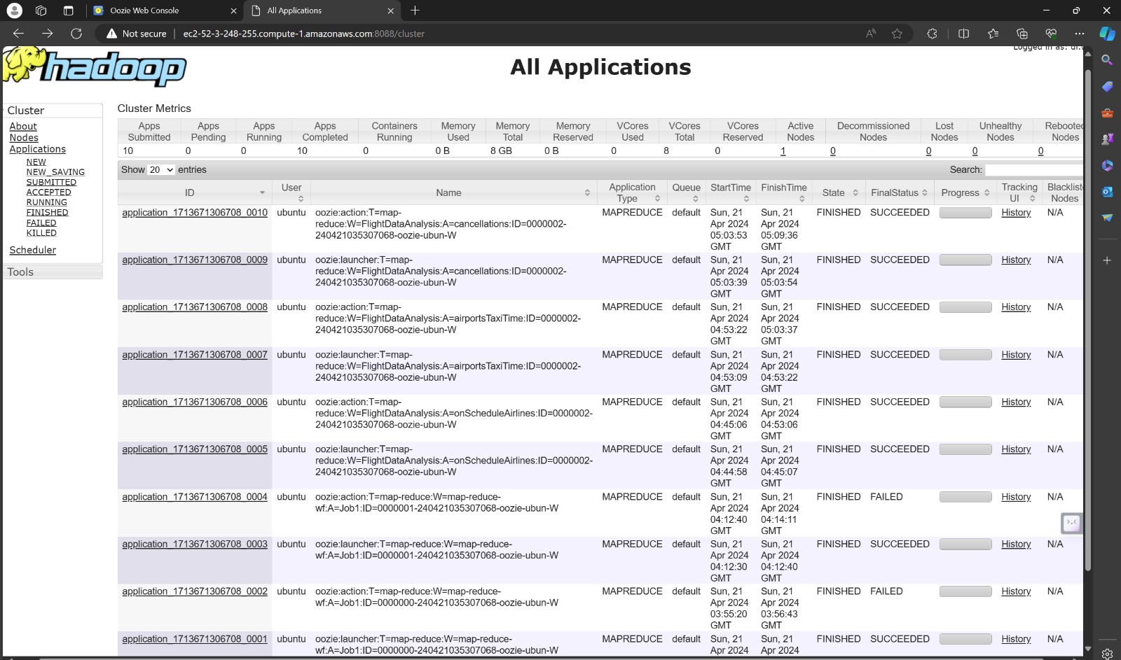

Slide 10
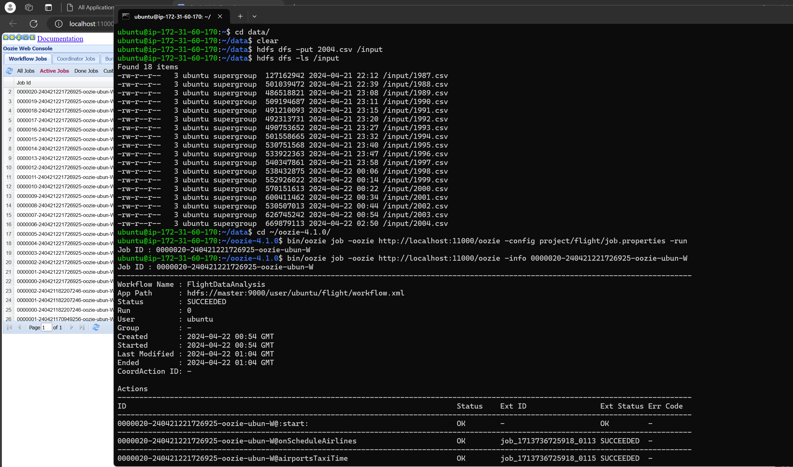

Slide 11

Workflow execution performance
Evaluation:
Workflow Scaling: Accessed the performance of the workflow by executing it on an increasing number of virtual machines (VMs) to measure scalability.
Time Measurements: Record the execution times for each scenario to evaluate the efficiency of the workflow.
Impact of Data Size: Compare the performance of the workflow for analyzing the entire dataset versus performing progressive analysis to understand the impact of data size on execution time and resource utilization.

Slide 12
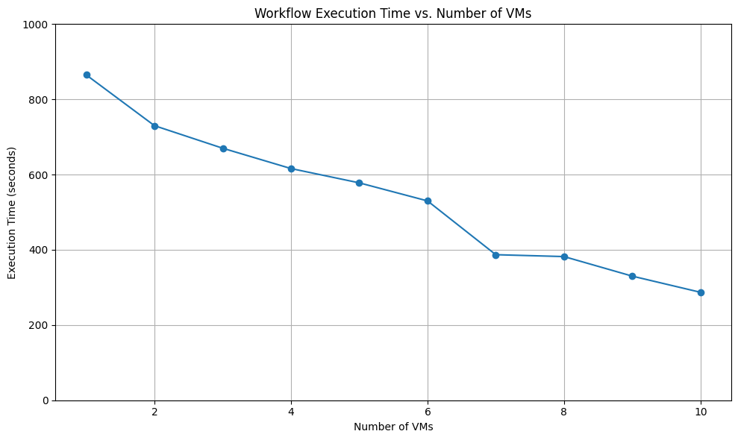

Slide 13
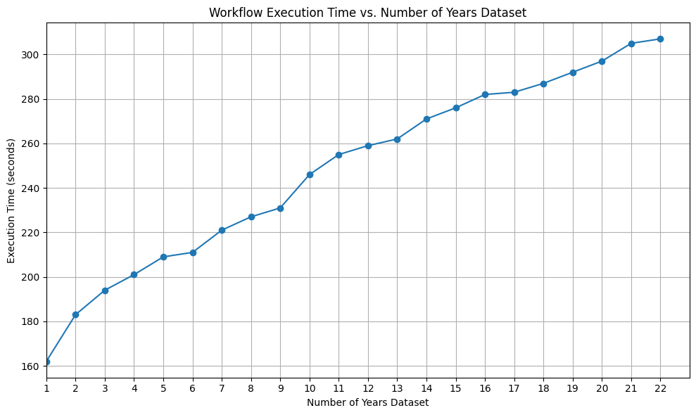

Slide 14
challenges
1. Installation of Oozie: Setting up Oozie was challenging due to its dependencies and configuration requirements.
2. Space management: Managing storage space for both the dataset and intermediate data generated during workflow execution felt complex, especially with large datasets.
3. Ensuring compatibility between Hadoop and Oozie versions: Ensuring that the versions of Hadoop and Oozie are compatible with each other and with other components of the Hadoop ecosystem was critical for smooth workflow execution.
4. Optimizing VM configurations for performance: Configuring virtual machines (VMs) to optimize performance, including memory allocation, CPU utilization, and network settings, is essential for efficient execution of the workflow.

Slide 15
conclusion
Successfully executed Flight Data Analysis using Oozie workflow with three mapreduce tasks.
This outlines a streamlined approach to analyzing airline performance metrics using a simplified Oozie workflow. By breaking down the analysis into three key tasks—identifying airlines with the highest and lowest on-time performance, determining airports with the longest and shortest average taxi times, and identifying the most common reasons for flight cancellations.

Slide 16
Thank you Any Questions?

